Slide 1
Initial Expedition Training Learning Outcome 4 First Aid and Emergencies
Uncontrolled copy not subject to amendment
Version 2.0 OCT 2014

Slide 2
What is Exposure?
Exposure to extreme climatic conditions
Extreme cold can lead to Hypothermia
Extreme heat can lead to Heat Stroke or exhaustion
Climatic conditions do not need to be extreme though!

Slide 3
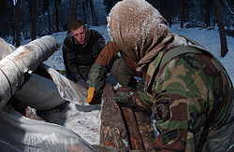
Hypothermia
Caused by a fall in core body temperature
If it is not stopped, it can lead to unconsciousness, respiratory or cardiac failure, and death
Younger people more likely to suffer
The UK climate can be as bad as the Arctic!

Slide 4
Causes of Hypothermia
Cold
Exhaustion
Tiredness
Low morale
Stress
Injury (Shock)

Slide 5
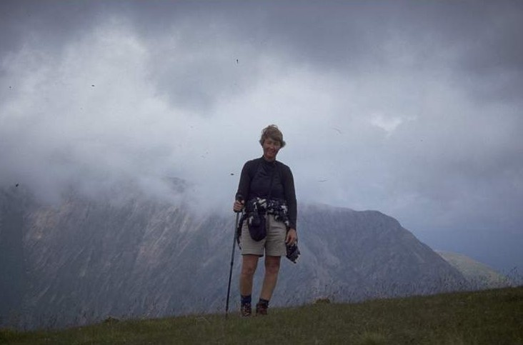
Causes – Bad Weather
If bad weather occurs, getting off the hill might not be the best move as this can lead to exhaustion
Windchill is often underestimated
Rain makes clothes wet and added wind makes the body cool quickly!

Slide 6
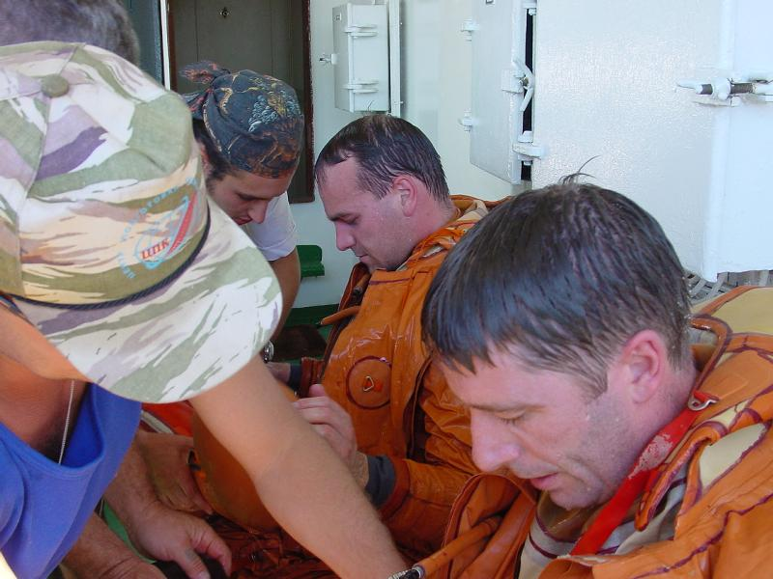
Causes - Exhaustion
Exhaustion can be brought on by trying to take on too much in one go
... or not having sufficient reserves of energy
Plan carefully, take plenty of stops for rest, fluid, and energy replacement
Don’t overdo it!

Slide 7
Symptoms of Hypothermia
Unexpected unreasonable behaviour
Complaints of coldness or tiredness
Physical or mental lethargy
Failure to respond to questions or directions
Slurring of speech
Failure to appreciate something is wrong
Failure or abnormality in vision in serious cases

Slide 8
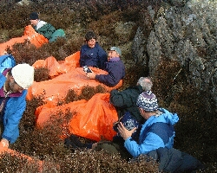
Treatment of Hypothermia
Get casualty into shelter – tent, hut, bivvi, etc
Remove wet clothing and
replace with dry
Put casualty into sleeping bag(s)
isolated from ground
Put another person into sleeping
bag to provide warmth
Provide warm drink
Resuscitate if required
Keep warm and still until evacuated – may relapse

Slide 9
Avoiding Hypothermia
Use proper walking equipment and waterproofs
Monitor the weather
Carry emergency food and a tent
Take a good meal at the start of an expedition
Know how to deal with problems when they arise
Plan properly!

Slide 10
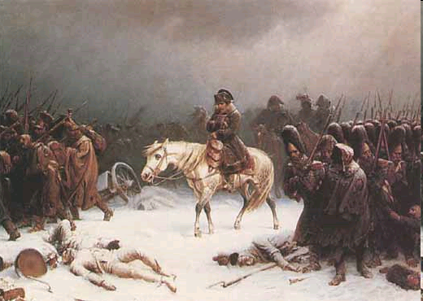
Hypothermia
The Russian Winter killed many of Napoleon’s troops:
Hypothermia turned the tide of a war.
Notes:
http://en.wikipedia.org/wiki/Hypothermia#Signs_and_symptoms
10

Slide 11
The Effects of Heat
Even in the UK, heat can be a problem
Serious sunburn and heat exhaustion can be major problems
Overheating can be a problem, even on cold days
Body must be properly ventilated and topped up with fluids

Slide 12
Dehydration
The body requires 2.5 litres of water per day
This may rise to 5 times that amount in the hills – 12 litres if the weather is really hot!
Fluid is lost through body sweat, which cools the shell
Salt is lost in sweat – if you loose too much, this can cause cramps
The body must be kept topped up – little and often

Slide 13
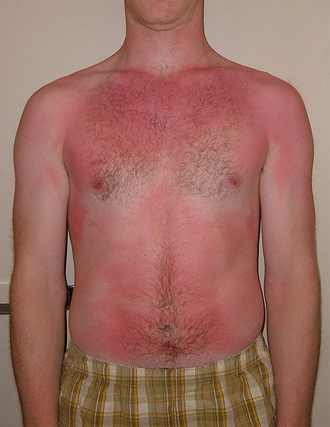
Sunburn
Skin which is not protected can burn and blister
Protect yourself with a high-factor barrier cream or sunblock
This doesn’t just happen in the summer!
High winds can produce wind burn
Treat with Calomine Lotion, or in severe cases, seek medical attention

Slide 14
Heat Exhaustion
Symptoms:
Thirst, Fatigue, Giddiness, Rapid pulse, High body temp, low urine output, delirium, coma, death
Can be avoided only be keeping body fluid intake up
Keep salt intake up too

Slide 15
Heat Stroke
Heat Stroke is very serious
The body’s temperature regulating system has failed
Symptoms:
High body temp, no sweating, skin dry to the touch, lack of coordination, coma, death
Sponge down with water, cool with damp cloth, immerse in cold water if possible

Slide 16
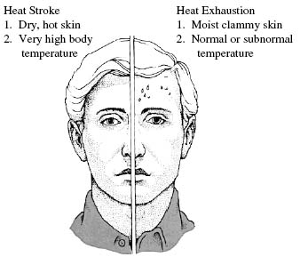
Heat exhaustion and heat stroke
Heat stroke is an emergency – phone 112
Notes:
Heat exhaustion is a milder form of heat-related illness that can develop after several days of exposure to high temperatures and inadequate or unbalanced replacement of fluids. Those most prone to heat exhaustion are elderly people, people with high blood pressure, and people working or exercising in a hot environment.
Heat exhaustion symptoms
Warning signs of heat exhaustion include:
heavy sweating paleness muscle cramps tiredness weakness dizziness headache
nausea or vomiting fainting
The skin may be cool and moist. The victim's pulse rate will be fast and weak, and breathing will be fast and shallow.
However, some individuals can develop symptoms of heat stroke suddenly and rapidly without warning.
Different people may have different symptoms and signs of heat stroke. But common symptoms and signs of heat stroke include
high body temperature the absence of sweating, with hot red or flushed dry skin rapid pulse difficulty breathing strange behaviour hallucinations confusion agitation disorientation seizure coma
Victims of heat stroke must receive immediate treatment to avoid permanent organ damage. First and foremost, cool the victim.
Get the victim to a shady area, remove clothing, apply cool or tepid water to the skin (for example you may spray the victim with cool water from a garden hose), fan the victim to promote sweating and evaporation, and place ice packs under armpits and groins. Monitor body temperature with a thermometer and continue cooling efforts until the body temperature drops to 101-102°F (38.3-38.8°C). Always notify emergency services (911) immediately. If their arrival is delayed, they can give you further instructions for treatment of the victim.
16

Slide 17
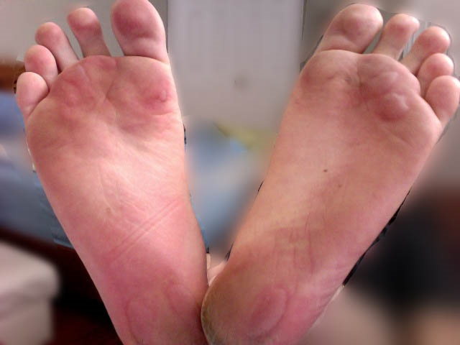
Blisters

Slide 18
Blisters
Blisters are potentially dangerous! Don’t underestimate them
Treat as soon as possible:
Smear with antiseptic
Cover with broad plaster or chiropody felt
Use special blister pads if available
Only burst in severe cases, but make sure skin is clean and needle is sterile
Change dressing daily, and at every chance, let it harden in fresh air

Slide 19
Getting help

